Slide 1
PID Ball Balancing System
Embedded Systems Lab

Slide 2
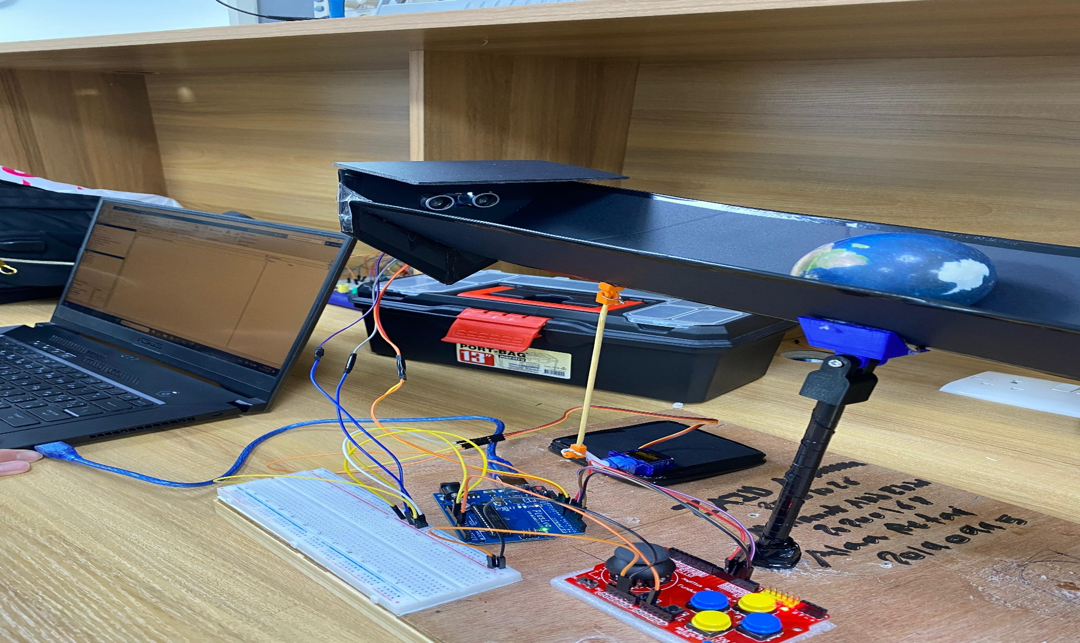
Hardware design

Slide 3
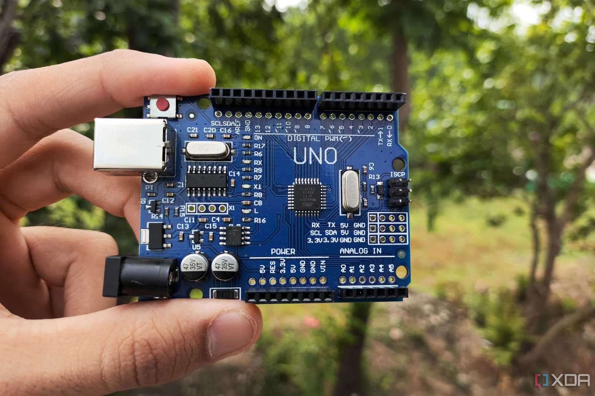
Microcontroller

Slide 4
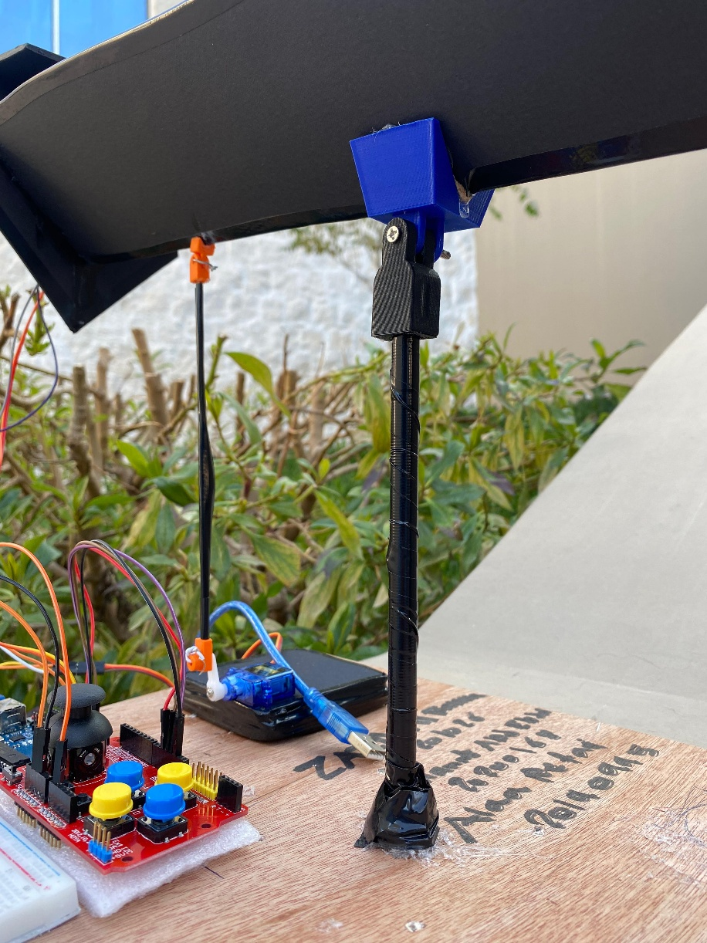
Base
Wooden base to place the project on
A pipe is used to hold the track up, the pipe is mounted on the wooden base
A flexible 3D-printed piece is placed on the top of the pipe that will hold the track

Slide 5
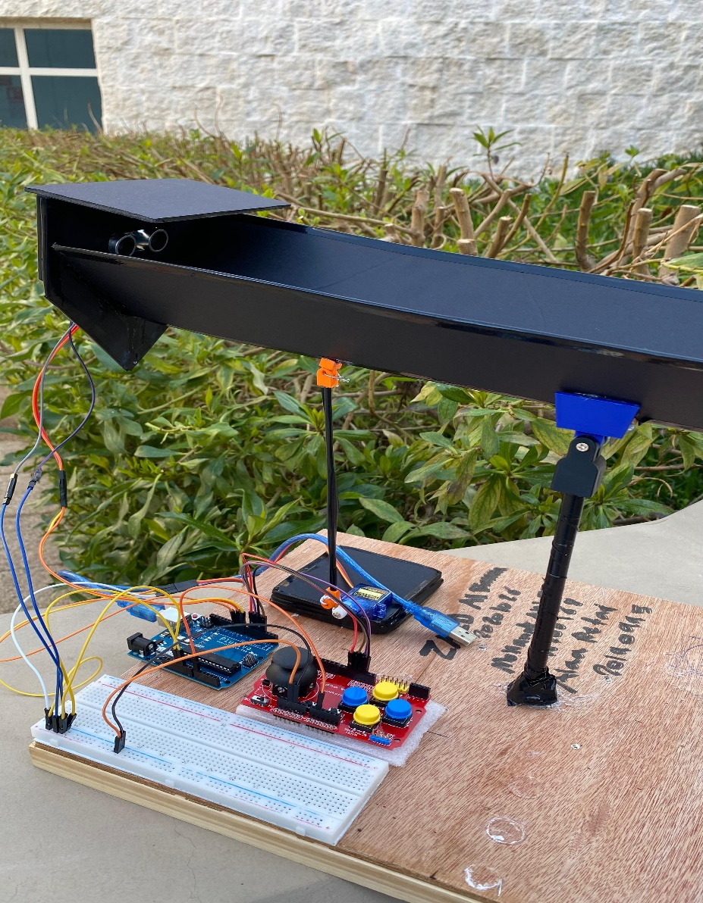
Track
Made out of foam
The ball will be moving through the track

Slide 6
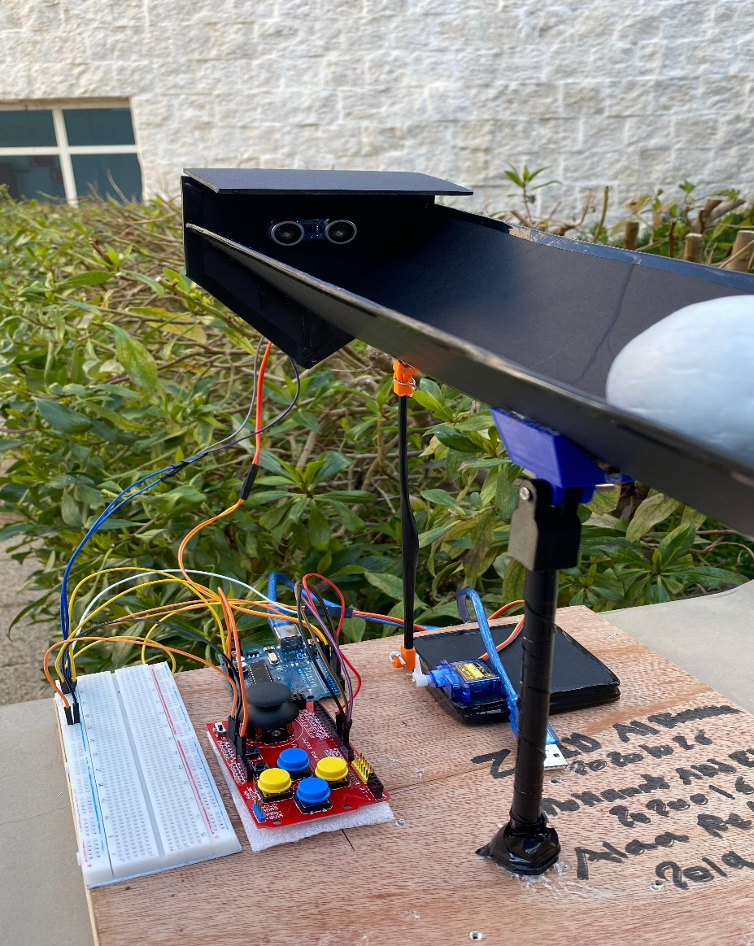
Distance measuring mechanism
An Ultrasonic sensor is used to measure the distance of the ball from the end of the track
The sensor is mounted on the end of the track
A shade is placed at the top of the sensor to increase accuracy

Slide 7
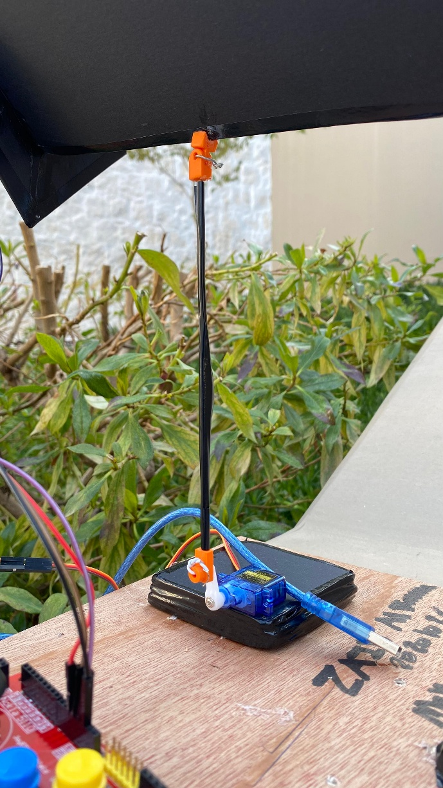
Moving mechanism
A Servo motor was used to control the track, it moves the track up and down

Slide 8
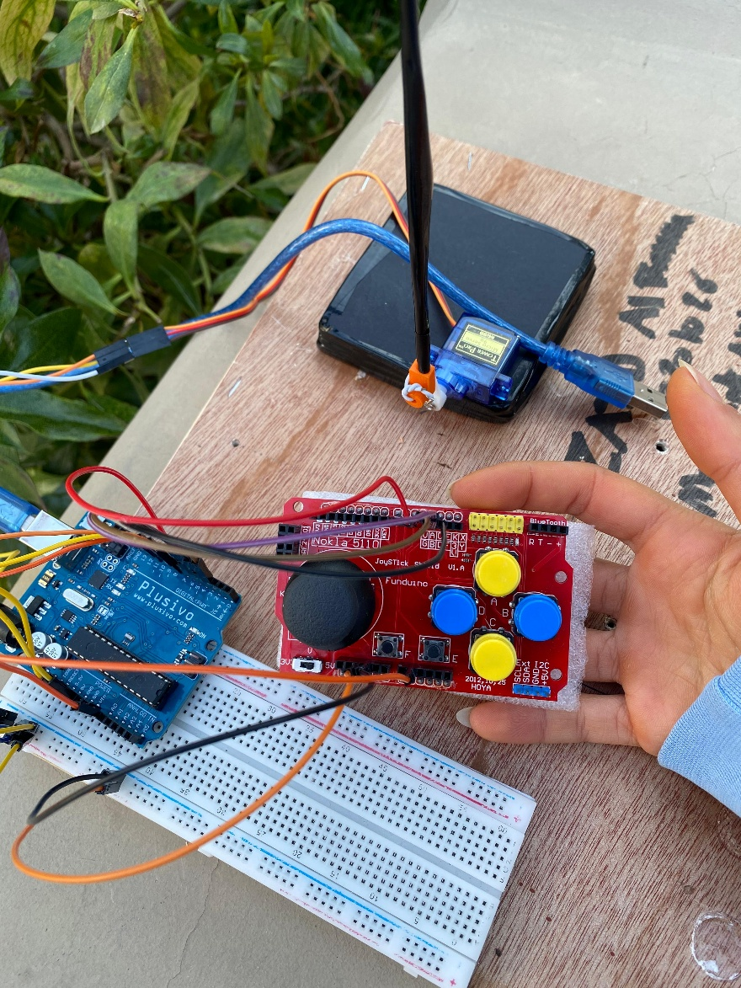
Joystick
Used to change the gain values Kp, Kd, and Ki

Slide 9
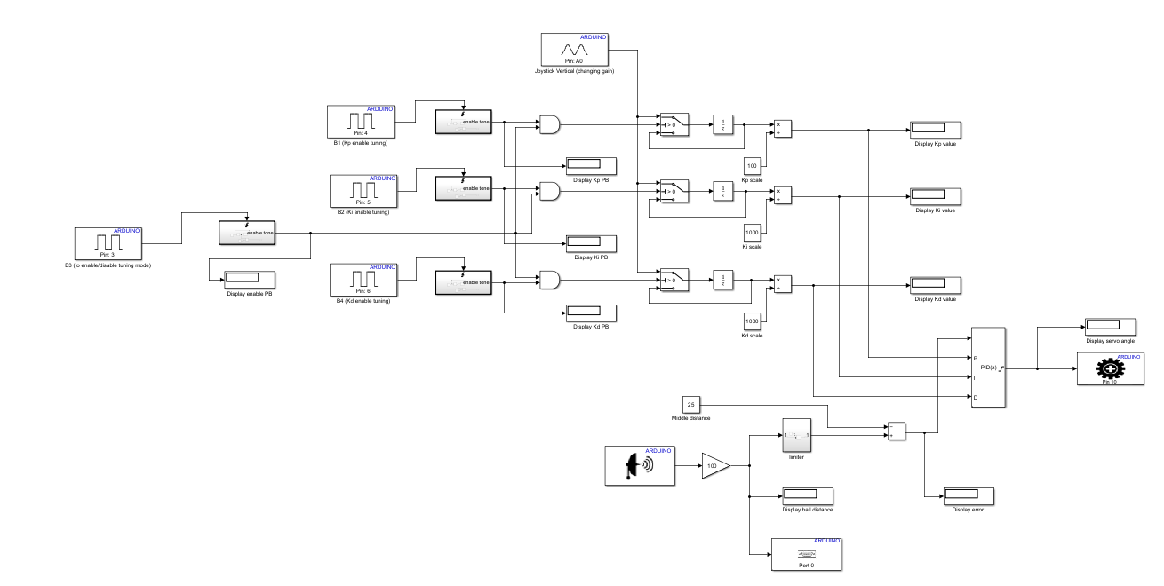
Software design

Slide 10
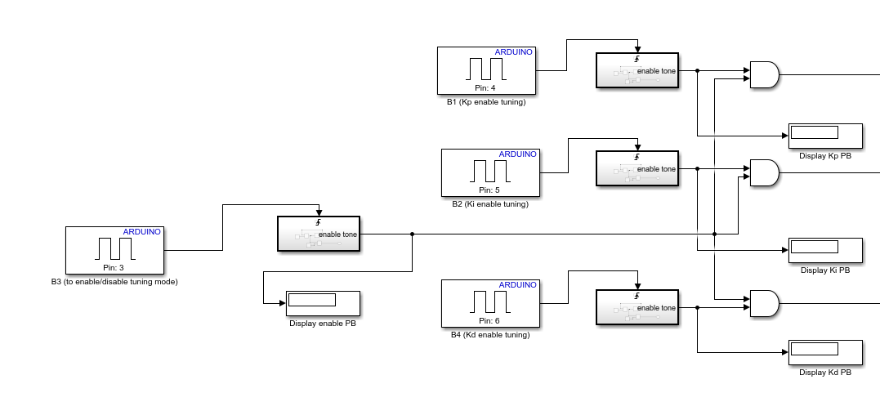
Joystick buttons

Slide 11
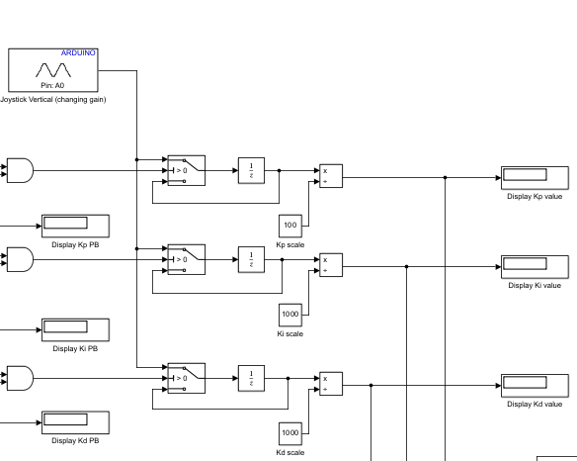
Analog input and scaling

Slide 12
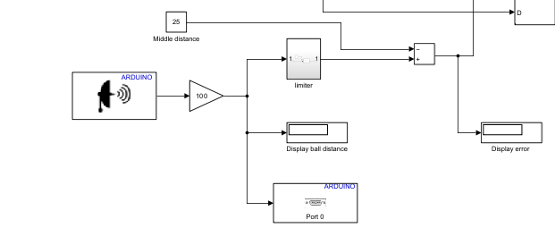
Ultrasonic and error calculation

Slide 13
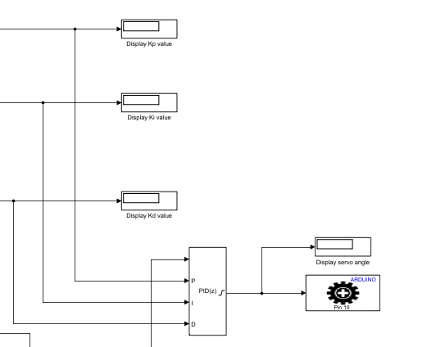
PID controller and servo

Slide 14
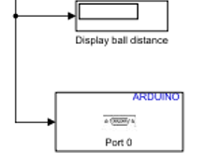
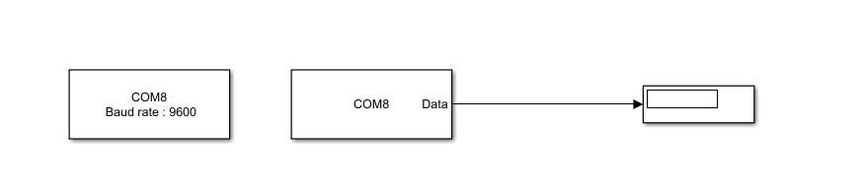
Serial

Slide 15
Thank you
By: Omar Tubeileh, Mariam Mourad & Yazan Al-Sharif
Supervised by: Eng.Raghda Al-Harasis

